Slide 1
SWITCHING THEORY AND LOGIC DESIGN
UNIT-4
BY
S.SAGAR KRISHNA,
ASSISTANT PROFESSOR,
GAYATRI VIDYA PARISHAD COLLEG OF ENGINEERIN(A)

Slide 2
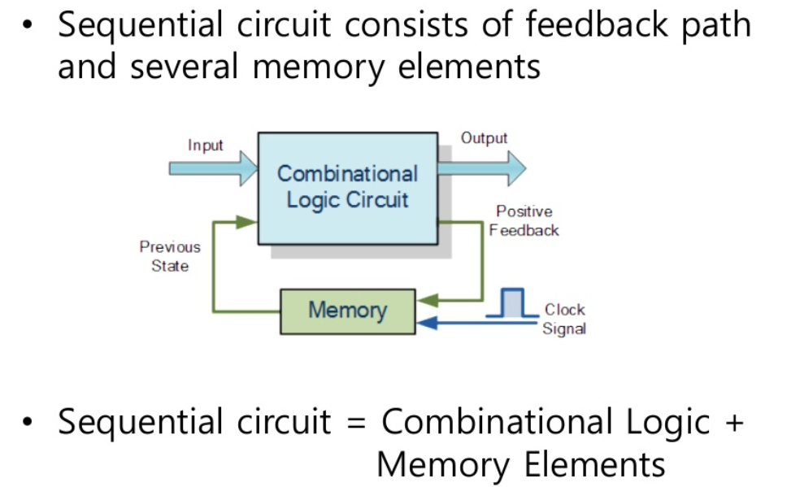
Sequential Circuits

Slide 3
Memory Elements in Sequential Circuits
Memory Element can either be a latch or flip-flop
Latch output is dependent on input and does not require a clock while flip flop output depends on clock and input.
One latch or one flip-flop can store 1 bit of information.

Slide 4
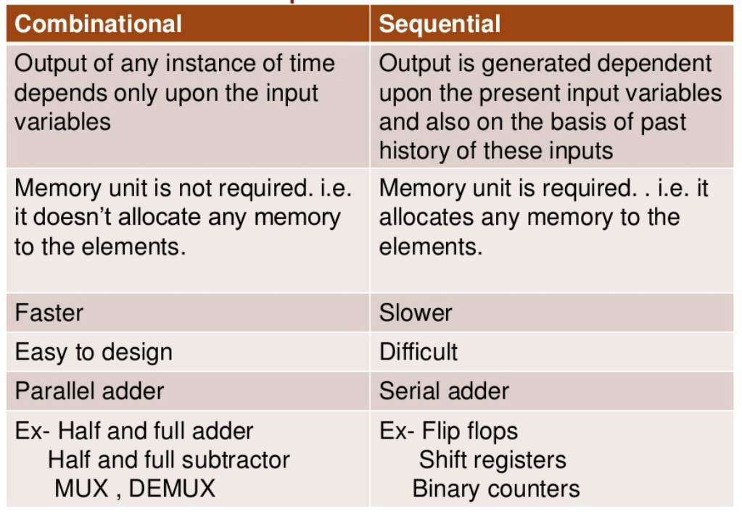
Differences between Combinational Circuits and Sequential Circuits

Slide 5
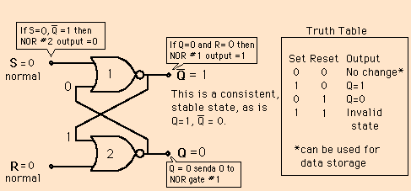
SR LATCH USING NOR GATE

Slide 6
SR LATCH USING NOR GATE
SET=0, RESET=0: has no effect on the output state. Q and Q‘ will remain in whatever state they were prior to the occurrence of this input condition. (No change State)
SET=0, RESET=1: this will always reset Q=0, where it will remain even after RESET returns to 0
SET=1, RESET=0: this will always set Q=1, where it will remain even after SET returns to 0.
SET=1,RESET=1; this condition tries to SET and RESET the latch at the same time, and it produces Q=Q‘=0. here outputs are unpredictable. This input condition should not be used.
Suppose inputs are applied in this way
S=0,R=0 then Q=0,Q’=1 (No change)
S=0,R=1 then Q=0,Q’=1, (Reset state)
S=1,R=0 then Q=1,Q’=0 (set state)
S=0,R=0 then Q=1,Q’=0(no change)

Slide 7
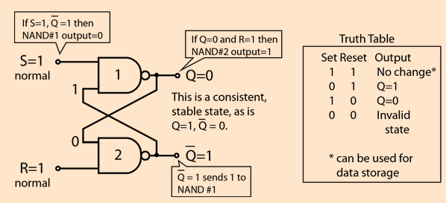
SR LATCH USING NAND GATE
Here States are reversed

Slide 8
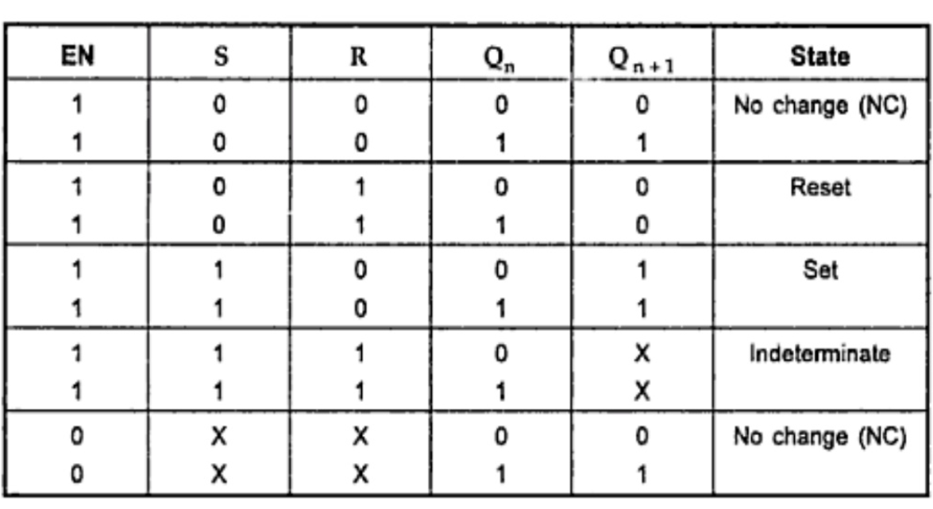
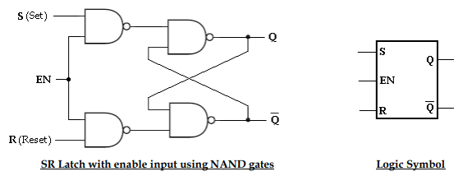
GATED SR LATCH USING NAND GATE
Functional Table
WHEN EN=1 SR LATCH OTHERWISE PREVIOUS STATE IS RETAINED

Slide 9
OTHER LATCHES
D LATCH
JK LATCH
T LATCH
Working of this will be same as working of flip-flops only difference is latch need not require clock

Slide 10
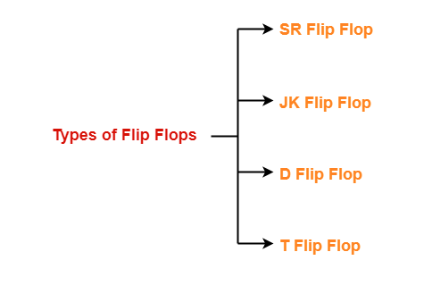
FLIP-FLOP

Slide 11
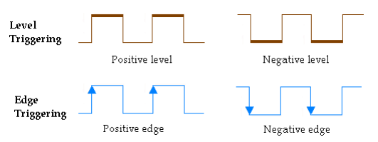
TRIGGERING OF FLIP-FLOP
CLOCKS WILL NORMALLY BE EDGE TRIGGERING

Slide 12
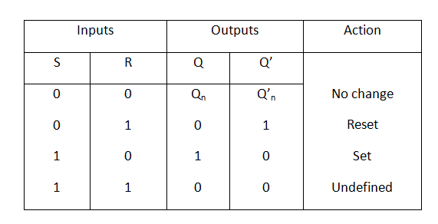
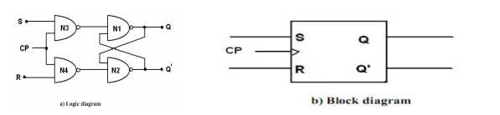
SR FLIP-FLOP
c) Functional Table

Slide 13
SR FLIP-FLOP
When CP=0 the output of N3 and N4 are 1 regardless of the value of S and R. This is given as input to N1 and N2. This makes the previous value of Q and Q‘ unchanged.
When CP=1 the information at S and R inputs are allowed to reach the latch and change of state in flip-flop takes place.
CP=1, S=1, R=0 gives the SET state i.e., Q=1, Q‘=0.
CP=1, S=0, R=1 gives the RESET state i.e., Q=0, Q‘=1.
CP=1, S=0, R=0 does not affect the state of flip-flop.
CP=1, S=1, R=1 is not allowed, because it is not able to determine the next state. This condition is said to be a race condition.

Slide 14
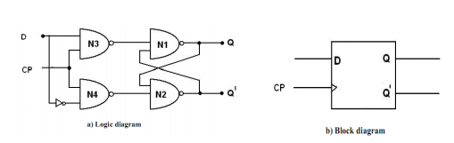

DFLIP-FLOP
The D flip-flop is the modified form of R-S flip-flop. S-R flip-flop is converted to D flip-flop by adding an inverter between S and R and only one input D is taken instead of S and R. So one input is D and complement of D is given as another input. The logic diagram and the block diagram of D flip-flop with clocked input
When the clock is low both the NAND gates (N1 and N2) are disabled and Q retains its last value. When clock is high both the gates are enabled and the input value at D is transferred to its output Q. D flip-flop is also called ―Data flip-flop. (Normally D-Flip-Flop is used in the design of Registers)

Slide 15
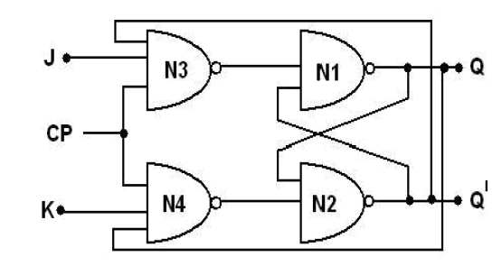
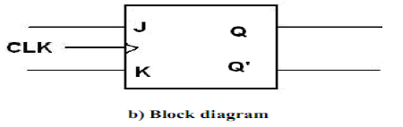
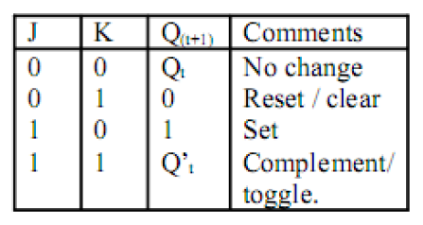
EDGE TRIGGERED JK FLIP-FLOP
c) Functional Table

Slide 16
EDGE TRIGGERED JK FLIP-FLOP
When J=0, K=0 then both N3 and N4 will produce high output and the previous value of Q and Q‘ retained as it is(No Change).
When J=0, K=1, N3 will get an output as 1 and output of N4 depends on the value of Q. The final output is Q=0, Q‘=1 i.e., reset state
When J=1, K=0 the output of N4 is 1 and N3 depends on the value of Q‘. The final output is Q=1 and Q‘=0 i.e., set state
When J=1, K=1, If Q=1, Q‘=0 then N4 passes ‘0‘to N2 which produces Q‘=1, Q=0 which is reset state. When J=1, K=1, Q changes to the complement of the last state. The flip-flop is said to be in the toggle state. (This State is normally used in the design of Counters)

Slide 17
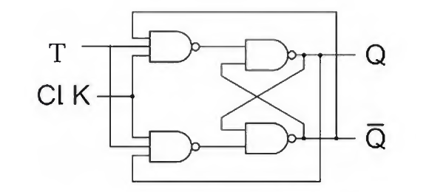
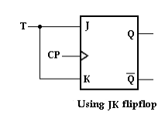
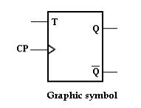
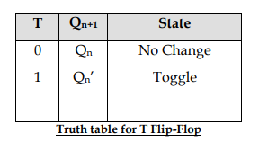
EDGE TRIGGERED T FLIP-FLOP
It T=0 NS=PS and if T=1 NS=PS’.
NS=NEXT STATE(Q_{N+1})
PS=PREVIOUS STATE(Q_{N})

Slide 18
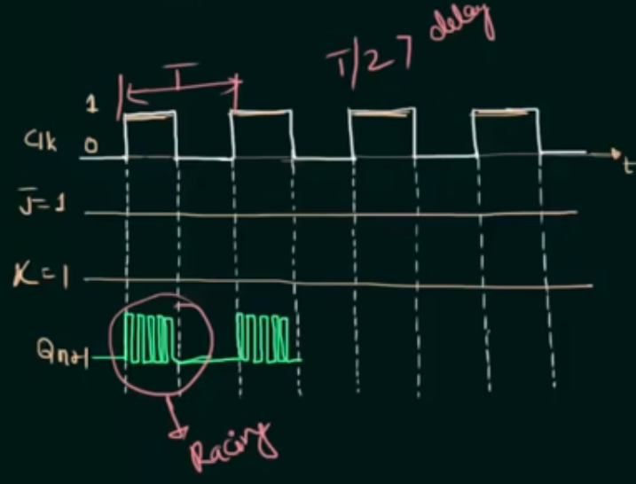
RACE AROUND CONDITION JK FLIP-FLOP
In level triggering, if J=1, K=1, the output changes its state continuously 1,0,1,0,1,0,1 without change in input.
https://www.youtube.com/watch?v=trPGhO7MPnw&itct=CAsQpDAYCSITCLDq0NCn5toCFVTZwQodmDYD3jIGcmVsbWZ1SPD0oZnyg_OXPg%3D%3D&app=desktop
(See this video to understand about it)
To avoid this go for edge triggering

Slide 19
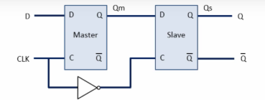
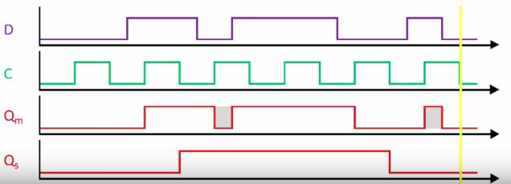
MASTER SLAVE D FLIP-FLOP
To avoid Race Around Condition we go for Master Slave Flip- Flops. We can use SR or JK or D or T Flip-Flops
Master will be active at positive level of the clock Qm=D and Qs=PS(Previous State)
Slave will be active at the negative level of the clock Qm=PS, and Qs=Qm
If clk=1 Qm=D but output will still be the previous state(Qs).So here without change in input the output remains same. Hence Race Around Condition is avoided.

Slide 20
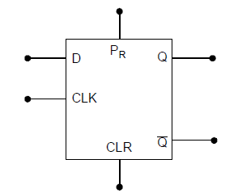
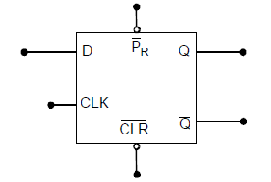
D FLIP-FLOP WITH PRESET AND CLEAR
When Preset(Pr)=1 and clear(CLR)=1 it will act as D flip-flop
Otherwise as SR latch
When Preset(Pr)=0 and clear(CLR)=0 it will act as D flip-flop
Otherwise as SR latch

Slide 21
FLIP-FLOP EXCITATION TABLE
Used in conversion of Flip-Flops and design of Synchronous Counter
Depending on output, input is derived
See this video how excitation table is written for SR Flip-Flop. Same Procedure can be adopted for other flip-flops.
https://www.youtube.com/watch?v=uiKKRPZbuXA

Slide 22
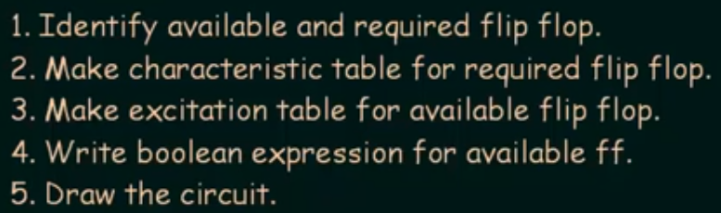
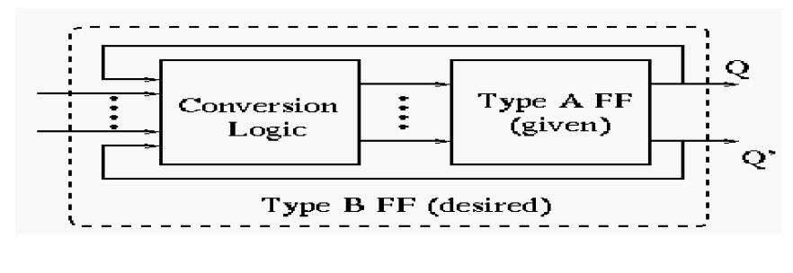
FLIP-FLOP CONVERSIONS
Procedure:

Slide 23
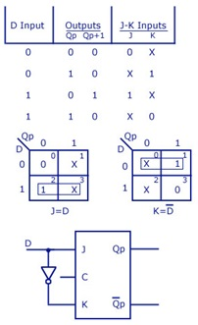
JK FLIP-FLOP TO D-FLIP-FLOP CONVERSION
1.Available=JK, Required=D
2.Write characteristic table(functional table) of D flip-flop.
3.Write Excitation table of JK Flip-Flop
4.Write Boolean Expressions for JK Flip-flop
5.Draw the circuit.
https://www.youtube.com/watch?v=ApJ972OYyXQ
(See this video if procedure is not clear)

Slide 24
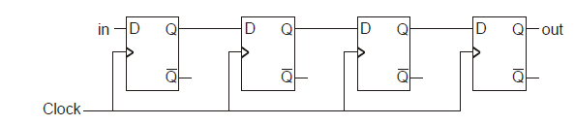
SHIFT REGISTERS
Different types of Shift Registers are available
Serial In - Serial Out Shift Register(SISO)
Serial In- Parallel Out Shift Register(SIPO)
Parallel In - Serial Out Shift Register(PISO)
Parallel In - Parallel Out Shift Register (PIPO)
Bidirectional Shift Registers for 2 types of Shift
Universal Shift Register
Serial In - Serial Out Shift Register(SISO)
Serial means single input and serial output means only one output
The input data is applied sequentially to the D input of the first flip-flop on the left (FF0). During each clock pulse, one bit is transmitted from left to right.
Assume a data input to be 1. the data input reaches FF3 after 4 clock pulses.

Slide 25
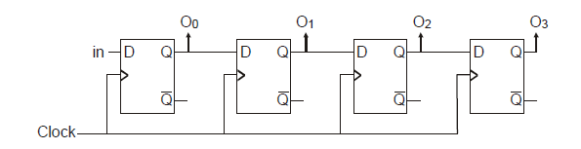
SERIAL IN- PARALLEL OUT SHIFT REGISTERS
Serial means single input and parallel output means output is taken in parallel
At each clock, Q₀ =in , Q₁ = PS of Q₀ , Q₂ = PS of Q₁ , Q₃ = PS of Q₂
After 4 clocks Q₃ =D.
No of Clock | Input | Q₀ | Q₁ | Q₂ | Q₃
0 | X | 0 | 0 | 0 | 0
1 | 1 | 1 | 0 | 0 | 0
2 | 0 | 0 | 1 | 0 | 0
3 | 1 | 1 | 0 | 1 | 0
4 | 1 | 1 | 1 | 0 | 1
Logic Diagram
Functional Table
Similarly other type of Shift Registers

Slide 26
THANK YOU

